Slide 1
News-editing in the AI age

Slide 2
Why News Trans-editing?
News is especially suitable for AI-integrated translation teaching.
News texts have clear constraints.
Ttime Pressure: News has to be processed quickly.
Factual density: Names, numbers, dates, places and titles must be handled accurately.
Genre conventions: Headlines, leads, attribution and paragraphing follow recognizable patterns.
Audience orientation: Different readers require different degrees of background and explanation.
Ethical sensitivity: Bias, legal risk, attribution and verification are central.
Platform variation: A story can become a headline, push alert, social teaser, short news item or explainer.

Slide 3
The AI-Age Teaching Challenge
Before AI
Students often struggle with:
Comprehension
Vocabulary
Sentence structure
Idiomatic expression
Target-language fluency

Slide 4
With AI
The visible language problem is partly reduced But deeper editorial problems become more important:
What is the news angle?
What should be foregrounded?
What must be verified?
What can be omitted?
What needs localization?
What should not be “improved” by AI?
What legal or ethical caution is required?
Pedagogical shift:
From correcting language errors to evaluating editorial decisions.

Slide 5
News Worthiness
News Values: Timeliness, Impact, Proximity/ relevance, Oddity, Conflict, Celebrity, Human Interest/ emotion.
These news values change with translation and therefore need to be reconsidered in news trans-editing.

Slide 6
Key Dimensions of News Trans-editing
Language Adaptation: clarity and fluency
Contextualizing News: background info etc.
Maintaining Journalistic Integrity: accuracy, impartiality
Tailoring for Local Relevance: reader’s interest & concerns
Adapting News-writing style
Ensuring Cultural Sensitivity
Managing ideological shift
Prompting without genre knowledge produces fluent but unreliable output.

Slide 7
Style guide tensions(1): Headline style
English: compressed, verb-driven, centralized info.
Chinese: may be fuller, more rhythmical, sometimes more evaluative depending on the platform, esp. in local news (relevance)
E.g. 公安部原副部长李东生受贿获刑15年
China jails ex-national police deputy
偷渡男医院抢枪轰警
北区急症室发难 6发全开警臂中弹
Gunshot chaos in hospital
强冠董事长涉地沟油遭羁押
Boss of Taiwan ‘gutter oil’ company detained

Slide 8
Style guide tension (2): Lead style
English and Chinese lead share the same features:
Informative
Economical—often one sentence of around 20-30 words, though Chinese leads may be longer
Appealing
Clear and specific
Differences:
English leads tend to foreground the most newsworthy point quickly
Chinese leads may carry more context, official framing, or background information.

Slide 9
Some basic rules for Eng. News lead:
Rule 1: Avoid start an English lead with a prepositional phrase. (when and where)
Rule 2: Use an immediate identification lead only for famous people, places or things
Rule 3: Don’t start with a source
Rule 4: Key information preferably goes first
Rule 5: Avoid jargon.
Rule 6: Every word must count.

Slide 10
E.g 沙田大浦道凌晨发生车祸，司机当场死亡，十二名乘客重伤。
The driver died and 12 passengers suffered severe injuries early this morning in a one-bus accident on Taipo Road in Shatin.
July 14 (Reuters)- The death toll from twin earthquakes in Venezuela last month has risen to 4734, according to figures released by top lawmaker Jorge Rodriguez on Tuesday.
The number of injured in the June 24 quakes was unchanged at 16740, while 17907 people remained homeless.
据新华社加拉加斯7月14日电-委内瑞拉全国代表大会主席豪尔赫·罗德里格斯14日在社交媒体发文说，该国6月24日发生的两次强震已造成4734人死亡、16740人受伤。

Slide 11
周二，冰雨和停电连续第三天搅乱了莫斯科的航空运输，导致数以千计的旅客受困机场。由于缺少食物，加上资讯沟通不畅，愤怒的旅客在莫斯科主要机场殴打了俄罗斯国际航空公司（Aeroflot）的工作人员。
AI Translation:
On Tuesday, freezing rain and power outages disrupted air travel in Moscow for a third consecutive day, leaving thousands of passengers stranded at airports. With food supplies running short and information poorly communicated, angry passengers assaulted staff members of Aeroflot, Russia’s flagship carrier, at Moscow’s main airport.

Slide 12
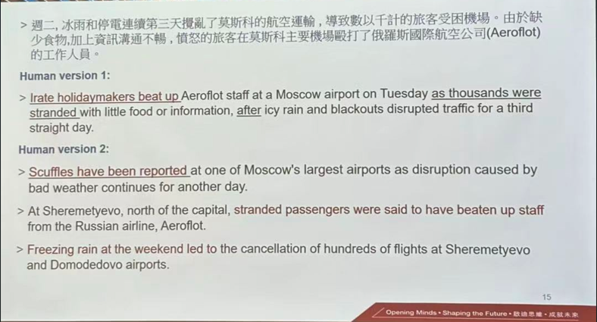

Slide 13
Style guide tensions (3): Localisation
Hongkong readers, mainland readers and international readers may need different backgrounds.
Hong Kong boat crash off Lamma Island kills 36
A collision between two passenger boats off Hong Kong has left at least 36 people dead, officials say.
........
Lamma lies some 3km (two miles) south-west of Hong Kong Island, and is popular with tourists and expatriates.
Hong Kong is one of the world's busiest shipping channels, but its ferries have a good safety record.
In in the UK, the government recommends eating no more than 70g of read or processed meat a day –
the equivalent of two slices of bacon.
根據英國政府有關部門的建議，每人每天食用的紅肉不應當超過70克，相當於一根半臘腸。

Slide 14
Style guide tensions (4): Register and political nuance
Some terms are not neutral across contexts.
Examples:
“said” vs. “claimed”
“riot” vs. “protest”
“mainland” vs. “China”
“officials said” vs. “state media said”
外交部发言人称，有关制裁“完全没有法律依据”。
The spokesperson claimed the sanctions had "no legal basis whatsoever." (x)
Said, stated...

Slide 15
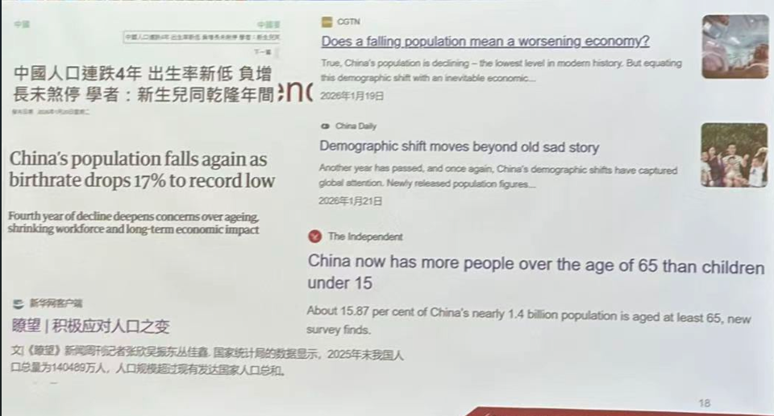

Slide 16
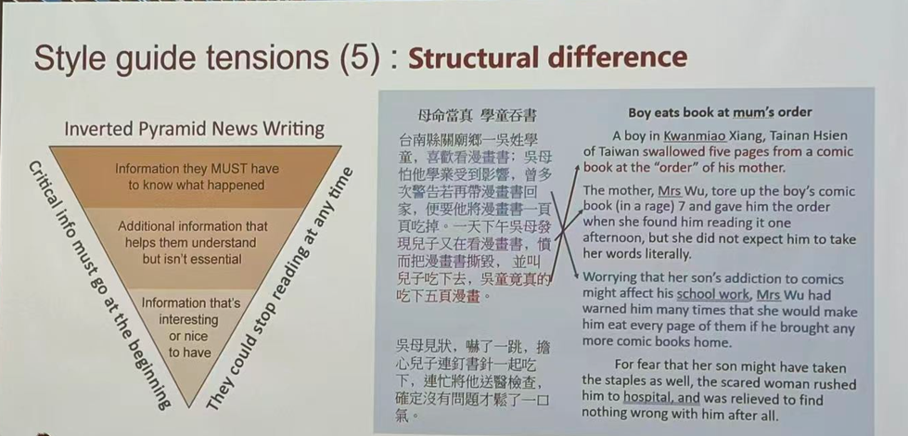
Style guide tension (5): structural difference

Slide 17
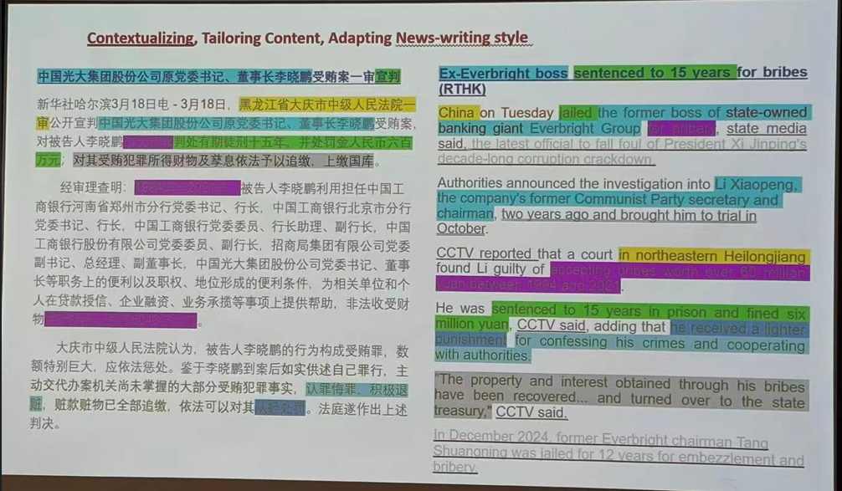

Slide 18
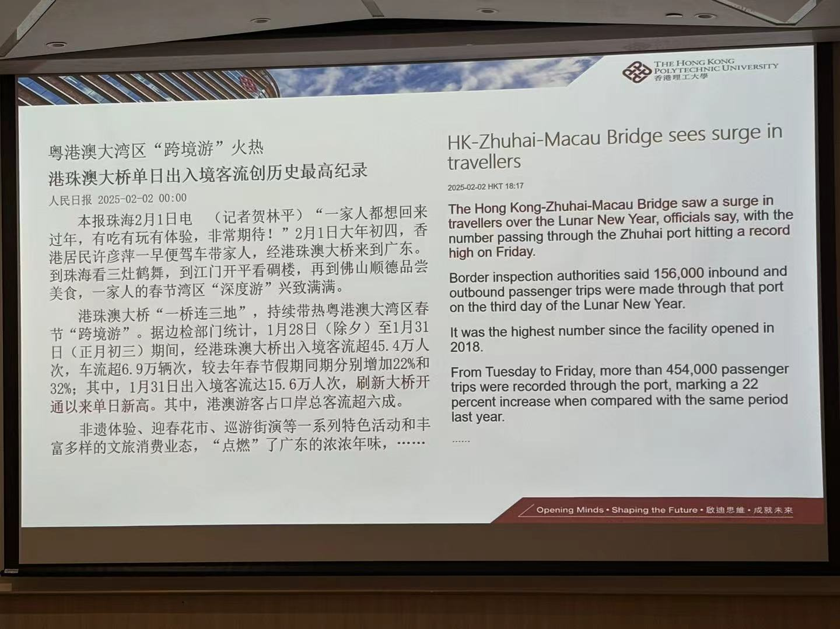

Slide 19
AI in the news ecosystem
AI is already used or discussed in many newsroom-related tasks:
Automated News Writing
Fact-checking support
Data Extraction / Analysis
Personalized News Feeds
Transcription and Translation (AP)
AI-Generated Visual Content
Story Summarization /headline draft
Style / grammar checking

Slide 20
Where AI Enters the Workflow
Stage | Human decision | AI support
Comprehension | Identify story angle, key facts, and sensitive points. | Summarizes; extracts facts
Selection / Deletion / Restructuring | Decide what to keep, omit, shorten, or foreground. | Suggests cuts, summaries, and order.
Terminology | Verify names, titles, institutions, and terms. | Suggest glossary; checks consistency
Drafting | -Judge accuracy, readability, and genre fit | Produce initial translation or trans-edited draft.
Headline / Lead | Frame the story clearly and accurately | Generate headline and lead options
Localization / Contextualization | Decide what background readers need | Suggests context or knowledge gaps.
Style editing | Match platform style, tone, register, and length | Improve fluency, concision, readability, and news style.
Verification | Check facts, attribution, risks, and source consistency. | Compares source and draft; flags issues.

Slide 21
Possibility of creating a Multi-Agent System
Workflow stage | Possible AI agent
Source Comprehension | Source Analyst
Selection / Deletion / Restructuring | News Editor
Terminology | Terminology Checker
Drafting | Translator / Trans-Editor
Headline / Lead | Headline & Lead Editor
Localization / Contextualization | Audience Editor
Style editing | Style Editor
Verification | Fact & Risk Checker
Multi-agent AI can simulate a newsroom workflow, but students should remain the final accountable editors.

Slide 22
Why Not Focus on One Specific AI Tool?
AI tools change quickly.
Students may have unequal access to paid tools.
Different institutions have different policies.
Tool performance varies by task, language pair and news genre.
Over-reliance reduces transferability.
The goal is to train transferable AI literacy and editorial judgment, not dependence on one tool.

Slide 23
Prompting Principles for AI-Assisted News Trans-Editing
Define the role
Ask AI to act as a news trans-editor, not just a translator.
Specify the task
Translation, compression, headline rewriting, lead revision, style editing, or verification.
Provide context
Source, target audience, platform, news genre, and intended length.
Set constraints
Preserve facts, attribution, tone, legal caution, and journalistic neutrality.
Request options
Ask for alternative headlines, leads, structures, or wording choices.
Require justification
Ask AI to explain major changes, omissions, or framing choices.
Verify, then revise
Treat AI output as a draft, not as the final version.

Slide 24
In actual use, prompts do not have to be long; they just need to be clear, practical, and followed by careful checking and revision.

Slide 25
Prompt used
Act as a bilingual news editor. Trans-edit the Chinese news report into English for readers in Hong Kong.
Requirements:
150-200 words;
English hard-news writing style;
Retain names, numbers, dates and attribution accurately;
Add background info for Hong Kong readers;
List any facts that require manual verification.

Slide 26
Discussion: What AI Did Well and Poorly
Which AI error was most dangerous?
Which AI error was most subtle?
Which AI error would students probably miss?
What kind of prompt or workflow might prevent this?
What human knowledge is still required?
How would you turn this error into a teachable moment?

Slide 27
What AI Did Well and Poorly
Common wins:
speed;
variant generation;
headline brainstorming;
gisting;
terminology recall;
structure suggestions;
concise rewriting.
Common failures:
numbers and dates drift;
invented background;
loss of attribution;
overconfident causal language;
loaded terms;
wrong register;
inappropriate localization;
headline sensationalism;
failure to understand legal caution;
outdated information.
Students accepting AI explanations uncritically

